Slide 1
Shooters Gotta Shoot
By: Prajit Ramaprasad, Trevor Grier, and Kyle Johnson

Slide 2
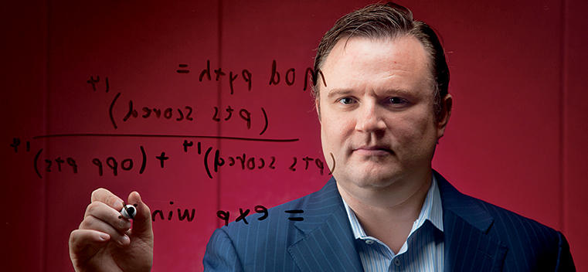
“TAKE THAT FOR DATA”
The NBA has made a heavy move towards analytics in recent years
Pioneers such as Houston Rockets GM, Darryl Morey have used analytics to construct optimal rosters, make crucial personnel decisions, and even develop coaching strategies
Darryl Morey even hosts the annual MIT Sloan Sports Analytic Summit

Slide 3

The Ask
Who are the NBA’s worst shooters?
Who are the NBA’s best shooters?
What players have the most drastic away and home shooting splits?
Who is the most clutch shooter?
Who is the worst shooter
What is the best shot?
What kind of shots are made in close games?

Slide 4
Methods
To start our data analysis we used an NBA Shot Logs CSV that was scraped from the NBA API for the 2014-2015 NBA season
Data was on shots taken during the 2014-2015 season, who took the shot, where on the floor was the shot taken from, who was the nearest defender, how far away was the nearest defender, time on the shot clock, and other factors
We used primarily Pandas, MatPlotLib, and SeaBorn as tools for our analysis

Slide 5
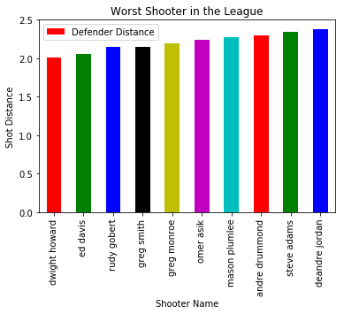
The Worst Shooters
Our methods for finding the worst shooter was to calculate the average distance of missed shots for NBA players
Our list skews towards big men, who technically are the worst shooters in the league
Long held beliefs about players like Dwight Howard, Rudy Gobert, DeAndre Jordan, and Andre Drummond seem to be confirmed by our graph

Slide 6
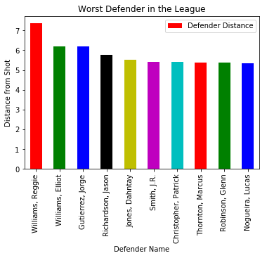
The Worst Defenders
Our methods for finding the worst defender was to look for the closest defender to made shots and then to aggregate the average distance from those shooters
By using distance from shooter we tried to highlight defenders that were completely out of position as opposed to guys that were simply just a victim of better offense
Similar to how the worst shooter has a big man bias, the worst defender has a guard bias

Slide 7
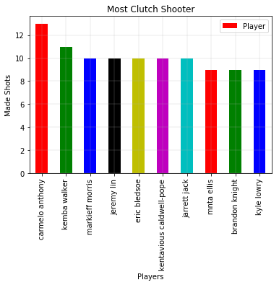
The Most Clutch Shooter
Our method for finding the most clutch shooter was to look at total amount of shots made by players in the 4th quarter with less than a minute less with a margin of less than 3
It is pretty surprising that major stars are not on the list outside of Carmelo Anthony, but this is likely because they avoid many close margin games with superior play
Almost all the players on the list are primary offensive options with the exception of KCP, Markieff Morris, and Jarrett Jack

Slide 8
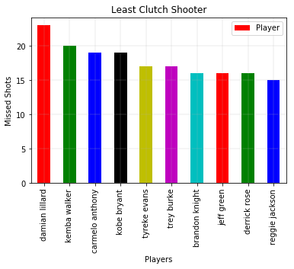
The Least Clutch Shooter
Our method for finding the most clutch shooter was to look at total amount of shots missed by players in the 4th quarter with less than a minute less with a margin of less than 3
Not surprisingly these players are almost all the best player on their team, as they would be entrusted at the end of the game
There is not a single big man in the list which seems to confirm that guard play is the king in the end of games
Carmelo Anthony and Kemba Walker are in the top 3 of both the most clutch and least clutch shooters

Slide 9
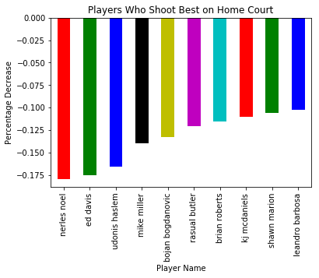
Home Dependent Shooters
Our method for finding which player had the greatest negative difference in home/away shooting splits was by aggregating shots by makes and misses and calculating how successful they were
It was interesting to see that the list of players that were successful at home were primarily veterans with the exception of Nerlen Noels, perhaps they just don’t handle travel as well in older age

Slide 10
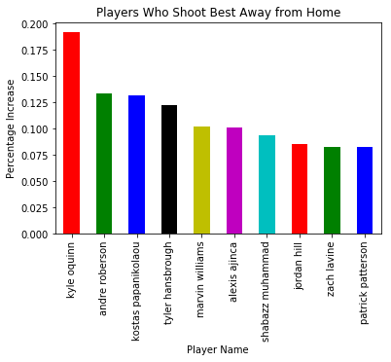
Best Away Shooters
Our method for finding which player had the most success shooting away from home was similar to how we found who the most home dependent shooters except reversing the results
This list was odd as with the exception of Zach Lavine, there isn’t a “good” offensive player on the list

Slide 11
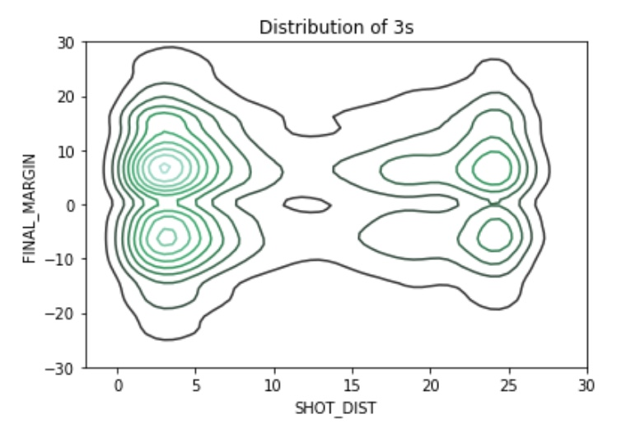
The Best Shots for Close Games?
Our method for finding this group by shots made in games, and then use a kernel density plot to show the distribution of three pointers
Despite three point shots being worth “more”, close range shots are made more most likely because they are safer and teams are also trying to get to the free throw line

Slide 12
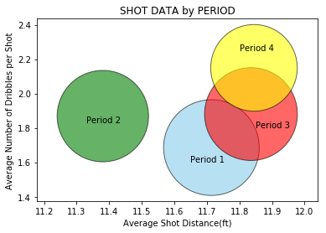
How does shot selection change during the game?
We isolated the average shot distance against the average number of dribbles for each period
The size of the plots reflect the amount of total shots made over course of the season
What we can see is that as the game goes on players will dribble more, attempt more 3s, and actually make less shots.

